Slide 1
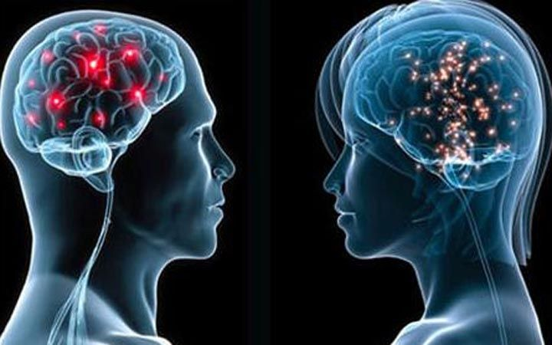
Unit 5
Gender Studies

Slide 2


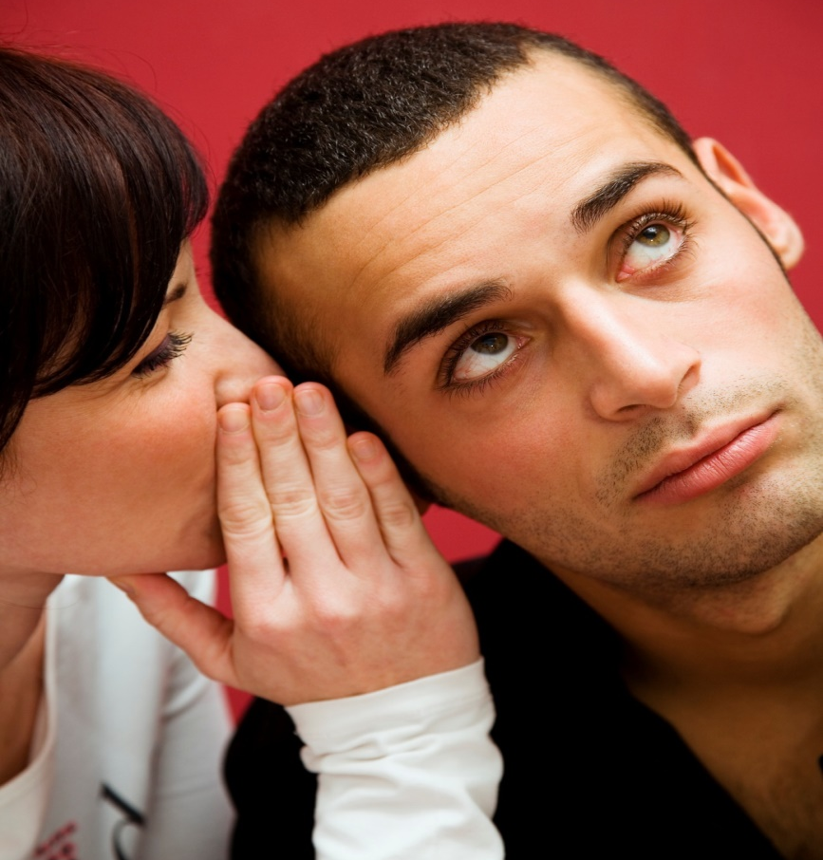
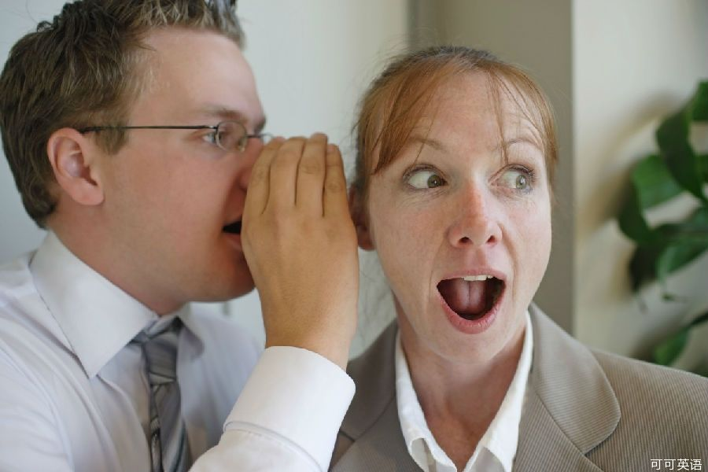
Text Comprehension
Text

Slide 3


Identifying the writer
Lead-in
Work in pairs. Discuss whether the writer of the passage is a man or a woman.

Slide 4
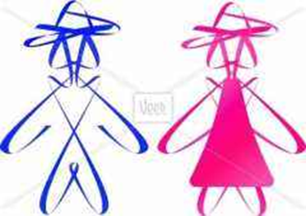


Identifying the writer
Lead-in
Work in pairs. Discuss whether the writer of the passage is a man or a woman.
Think about:
style of writing
attitude
vocabulary
the writer’s theory

Slide 5
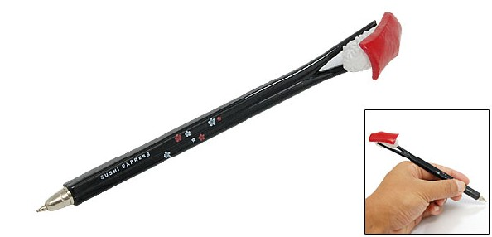
Lead-in
style of writing
a style which popularizes academic findings
But
this could be written by either a male or female writer.

Slide 6
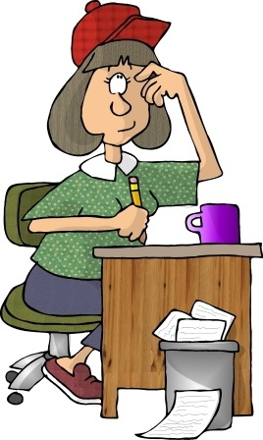
Lead-in
attitude
gossip is an interesting thing to study.
more likely that a woman would do
because of
popular ideas about gossip

Slide 7

Lead-in
vocabulary
Some of the vocabulary seems more feminine.
but
mostly quoted from other people and is not the writer’s own words

Slide 8
Lead-in
The writer’s theory
Idea 1
gossip is a topic worthy of research.
to draw conclusions in the form of three factors or “rules” that characterize female gossip and make it sound like gossip
Idea 2
Any social scientist could find “gossip” interesting as a research topic and could have formulated the three rules
what the passage says about the interviews and focus groups
method of investigation
what the female informants are reported as saying
The writer is a woman.
quote women reporting men’s behaviour but does not quote men talking about women

Slide 9

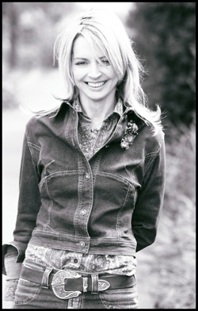
Cultural Notes
Kate Fox
a social anthropologist , co-director of the Social Issues Research Centre at the University of Oxford., and bestselling author of popular social science books. She is also a Fellow of the Institute for Cultural Research.

Slide 10

Cultural Notes
WATCHING THE ENGLISH, the best-selling 2008 book, is a cultural description of English ways of communicating (on topics like the weather or money) and behaving (at home, in the workplace or in the pub). She observes people’s behaviour, but also, as a social scientist, interviews people and conducts social experiments to reveal the social rules or underlying codes and customs. Other topics in the book include dress codes, ways of eating, queuing, and — the extract here — social gossip.
WATCHING THE ENGLISH has sold more than half a million copies and has been translated into many languages. Not only a worldwide bestseller, but also a set text for university anthropology courses, WATCHING THE ENGLISH has been widely praised as a revealing and entertaining dissection of the English national character.

Slide 11

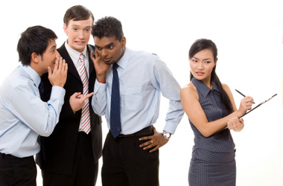
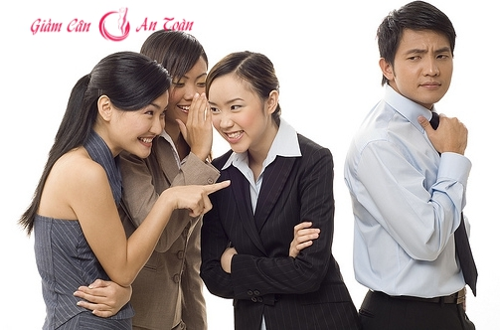
Text Organization

Slide 12
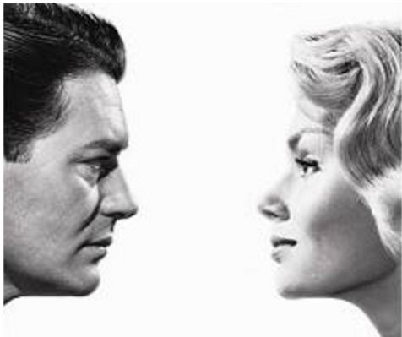
Text Organization
Sex differences in English gossip rules
An overview of the topic
Details 3 principal factors
Conclusion
The vital difference between male and female gossip lies in the positive response of the audience.

Slide 13
Text Organization
Refer to recent research to dispel the myth about male gossip.
Men gossip as much as women.
03
1
2. Reveal that men change topic of conversation when women are present.
To impress women.
2
Point
3. Focus on the difference of content between male and female gossip.
Solving the world’s problems VS gossip in the kitchen.
3
4
4. Suggest that the myth about male gossip
is really a problem of terminology.

Slide 14





Text Organization
01
02
03
The tone rule
The detail rule
The feedback rule
detailed speculation about possible motives, causes & outcomes
high & quick, or sometimes a stage whisper, but always highly animated
Listeners should be at least as animated and enthusiastic as speakers.

Slide 15
Text Organization
Number the different parts of the passage in the order in which they occur.
1
☐ Refer to recent research to dispel the myth about male gossip.
☐ Suggest that the myth about male gossip is really a problem of terminology.
☐ Reveal that men change the topic of conversation when women are present.
☐ Present a detailed, technical account of how women gossip.
☐ Focus on the difference of content between male and female gossip.
☐ Conclude that the vital difference between male and female gossip lies in the positive response of the audience.
4
2
5
3
6

Slide 16
Summary
Summarise the text by filling the blanks.
Researchers have found that men gossip as much as women and men spend much more time 1) __________________________. However, men don’t admit they gossip, instead they define it as 2) _______________________.
The reason why female gossip actually sounds like gossip is that there seem to be three principal factors involved. Firstly, the tone rule. Women adopt a tone which is 3) __________________, or sometimes 4) ____________________, but always 5) ________________, while men gossip in the same 6) ________________________ as any other piece of information.
talking about themselves
“exchanging information”
high and quick
a stage whisper
highly animated
flat, unemotional manner

Slide 17
Summary
Secondly, the detail rule. For women, a detailed speculation about 7) ____________________________
__________ are crucial. However, men find all this detail 8) ________________________________. Thirdly, the feedback rule. Female listeners are required to be at least as 9) ________________________________ as speakers. However, men who respond in such a manner would be considered inappropriately 10) _____, or even disturbingly 11) ____________. For them, 12) _____________________ is better to convey their surprise.
possible motives and causes,
outcomes
boring, irrelevant and unmanly
animated and enthusiastic
girly
effeminate
a suitable expletive

Slide 18
Difficult Sentences
… the difference was found to be quite small, with gossip accounting for …discussion of football could well account for the difference. (Para.1)
On further questioning, however, the difference turned out… the men defined as “exchanging information”. (Para. 4)
Clearly, there is a stigma attached to gossip among English males… it should be called something else. (Para. 5)
For women, this detailed speculation about possible motives and causes, requiring an exhaustive raking over “history”, is a crucial element of gossip. (Para. 8)
… it is understood that a suitable expletive conveys such surprise in a more acceptably masculine fashion. (Para. 10)

Slide 19
Language Points
Difficult Sentences
1. … the difference was found to be quite small, with gossip accounting for 55 per cent of male conversation time and 67 per cent of female time. As sport and leisure have been shown to occupy about ten per cent of conversation time, discussion of football could well account for the difference.
Researchers have found that men spend about ten per cent of their conversation time talking about sport and leisure, therefore the small difference between men and women in gossip time — men gossip about 12 per cent (67—55=12) less than women — can be explained by the time spent discussing football, which women are less likely to talk about, and which does not count as gossip.

Slide 20
Difficult Sentences
2. On further questioning, however, the difference turned out to be more a matter of semantics than practice: What the women were happy to call “gossip”, the men defined as “exchanging information”. (Para. 4)
Paraphrase the sentence.
When they were asked a bit more, the difference was more about the meaning of the word than about what they actually did: What the women called “gossip”, the men called “exchanging information” although the women and men were talking about the same activity.
Translate the sentence.
在接下来的提问中，我发现两者的差别只存在于语义层面上而非实践层面上：男性把女性通常所说的“闲聊”定义为“信息交流”。

Slide 21
Difficult Sentences
3. Clearly, there is a stigma attached to gossip among English males, an unwritten rule to the effect that, even if what one is doing is gossiping, it should be called something else. (Para 5)
click
Paraphrase the sentence.
English men feel there is sth. wrong or embarrassing about gossip and that there is a rule which is not written down, that is, if you are gossiping, you should give the activity another name.
Translate the sentence.
click
显然，在英国男性眼里闲聊是一件可耻的事情，这条不成文的规则已经深入人心，因此就算一个人确实是在闲聊，他也会把它说成是另外一回事。

Slide 22
Difficult Sentences
4. For women, this detailed speculation about possible motives and causes, requiring an exhaustive raking over “history”, is a crucial element of gossip. (Para 8)
Paraphrase the sentence.
click
For women there is an extremely important aspect of gossip – this is that they make guesses with details about why something might have happened. This means they feel they have to go over unpleasant aspects of the story in the past that other people do not want to talk about.
click
Translate the sentence.
对女人而言，周密地推测动机和原因与周密地推测可能的后果一样是闲聊的关键因素，这要求对“过去”进行仔细的梳理。

Slide 23
Difficult Sentences
5. … it is understood that a suitable expletive conveys such surprise in a more acceptably masculine fashion. (Para 10)
Paraphrase the sentence.
click
Everyone knows that in response to a particularly interesting bit of gossip, a listener can say dirty words to show their surprise. This way is more favored by men.
Translate the sentence.
click
人们认为一句恰到好处的脏话能以大家更容易接受的方式表达出男人在听到特别有趣的闲话时的震惊和惊讶。

Slide 24
Words & Phrases
Words & Expressions
gossip
— n. [U] conversation about unimportant subjects, especially people’s private lives （尤指关于人们私生活的）闲言，流言
— vi. to talk about other people or about things that are not important 闲聊；说长道短
e.g.
You miss a lot of office gossip when you have a day off work.
一天不上班，你就会错过办公室里的许多小道消息。
To say nothing to people to their faces but to gossip behind their backs, or to say nothing at a meeting but to gossip afterwards.
当面不说，背后乱说；开会不说，会后乱说。

Slide 25
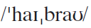
Words & Phrases
Words & Expressions
highbrow a. (of a book, film etc) very serious and may be difficult to understand（书籍、电影等）严肃的，高雅的，深奥难懂的，阳春白雪的
e.g.
1. They only attend highbrow events such as the ballet or the opera.
他们只参加高雅的活动，例如观看芭蕾舞或歌剧。
2. Opera has developed a reputation as a cultivated, highbrow sort of entertainment.
歌剧作为一种文雅且高雅的娱乐形式而声名远扬。

Slide 26
Words & Phrases
Words & Expressions
Antonym:
lowbrow a. characteristic of a person who is not cultivated or does not have intellectual tastes 教养浅薄的;文化修养浅薄的
e.g.
1. So far at least, commentaries in the official media have dwelt mainly on lowbrow entertainment on television and the internet.
至少到目前为止，官方媒体的评论主要涉及的是电视以及网上的低俗的娱乐节目。
2. It mixes and merges the established and the emerging, the high and the lowbrow, old and new media, global and local.
在这里，固有与新兴，阳春白雪与下里巴人，传统与新媒体，全球与本地的各种元素不断碰撞和融合。

Slide 27
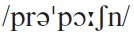
Words & Phrases
Words & Expressions
proportion n. [C] a quantity of sth. that is a part or share of the whole 部分；份儿
e.g. On average, fathers spoke less than mothers did, but they did not differ in the length of utterances or proportion of questions asked. (CET4-2009-12)
平均来看，父亲说的话比母亲说的要少，但是从表达的长度或者提问的多少来看，父亲和母亲之间没有什么区别。

Slide 28
Words & Phrases
Words & Expressions
Choose the ONE that best completes the sentence.
1. When carbon is added to iron in proper _______ the result is steel. (CET4-2004-06-51)
A) rates B) thicknesses
C) proportions D) densities
C
2.
A) composition B) compound
C) percent D) proportion
It is clear that the dog has a much greater _______ of its brain devoted to smell than is the case with humans. (CET4-2006-06-64)
D

Slide 29
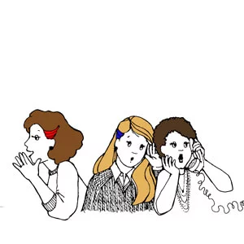
Words & Expressions
The tone rule
high & quick, or sometimes a stage whisper, but always highly animated

Slide 30
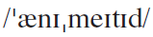
■ animated
Words & Expressions
adj. lively or active
Translate the sentences.
1. His observations gave rise to an animated and lively discussion.
他的言论引起了一场气氛热烈而活跃的讨论。
2. 运动是唯一能让他充满活力的事情。
Sport was the only thing that really animated him.
3. The animation of China made a great progress.
中国的卡通片制作取得很大发展。

Slide 31
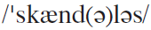
Words & Phrases
Words & Expressions
scandalous a. sth. that is scandalous is shocking because it involves immoral or dishonest behaviour 丑恶的；可耻的
e.g.
1. How in the world did he ever get mixed up in this scandalous affair?
他到底是怎样卷入到这件丑闻中去的？
2. Isadora Duncan, the dancer from San Francisco, gloried in an enlightenment which others thought scandalous.
来自旧金山的舞蹈家伊莎多拉·邓肯则醉心于别人认为丢脸 的启蒙活动。
Word family: scandal n.

Slide 32
Words & Phrases
Words & Expressions
Scandal n.
e.g.
In a major college admissions scandal that laid bare the elaborate lengths some wealthy parents will go to get their children into competitive American universities, federal prosecutors charged 50 people on Tuesday in a brazen scheme to buy spots in the freshman classes at Yale, Stanford and other big name schools.
在一场重大高校招生丑闻中，联邦检察官周二对50人提出指控，他们涉嫌参与通过行贿“购买”耶鲁、斯坦福及其它名校新生入学资格的无耻骗局。丑闻揭露出，一些富人家长为让孩子进入有竞争力的美国名校可以如何不择手段。

Slide 33
Words & Phrases
Words & Expressions
Scandal n.
e.g.
The scandal is certain to inflame longstanding complaints that children of the wealthy and well-connected have the inside track in college admissions — sometimes through big, timely donations from their parents — and that privilege begets privilege.
美国公众长期以来都对富裕子弟或是人脉深厚家庭子女就读名牌大学颇多抱怨，认为他们在入学时要么通过暗箱操作，要么靠家人给大学捐一大笔钱，轻松跨过高高的名校门槛。
Notes:
美国公众长期以来都对富裕子弟或是人脉深厚家庭子女就读名牌大学颇多抱怨，认为他们在入学时要么通过暗箱操作，要么靠家人给大学捐一大笔钱，轻松跨过高高的名校门槛。

Slide 34
Words & Phrases
Words & Expressions
Scandal n.
e.g.
A number of colleges moved quickly to fire or suspend the coaches and distance themselves from the scandal, portraying themselves as victims. Stanford fired the sailing coach, and USC dropped of its water polo coach and an athletic administrator. UCLA suspended its soccer coach, and Wake Forest did the same with its volleyball coach.
被点名的一些大学为了与丑闻撇清关系，迅速采取行动，解雇教练或者给予停职处罚，把自己描绘成受害者。斯坦福大学解雇了帆船教练，南加州大学解雇了水球教练和一名体育管理人员。加州大学洛杉矶分校暂停了足球教练的职务，维克森林大学也暂停了排球教练的职务。

Slide 35
sniff
Words & Expressions
v. to criticize sth., or to suggest is not good enough for you 对…嗤之以鼻；轻蔑地批评
Rewrite each sentence with sniff, keeping the same meaning.
You should not refuse such a good offer.
You should not _________________________________.
2. If I were you, I’d take the job. A salary like that is good enough to consider.
If I were you, I’d take the job. _____________________ ________________________.
sniff at such a good offer
A salary like that is
not to be sniffed at

Slide 36
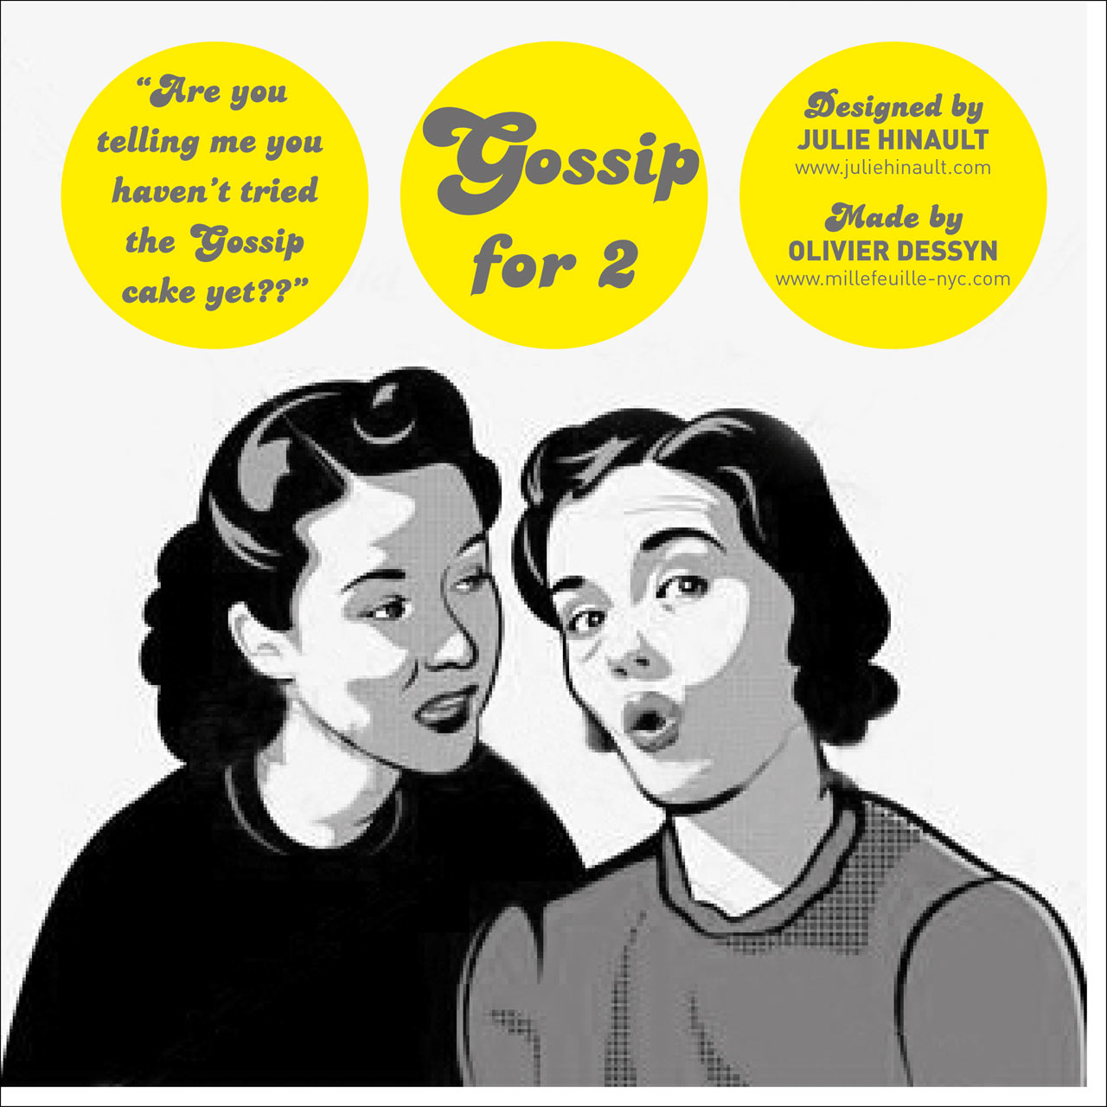
Words & Expressions
The detail rule
detailed speculation about possible motives, causes & outcomes

Slide 37
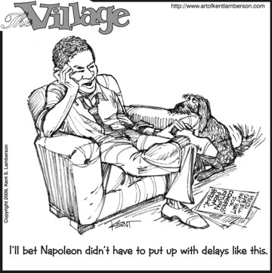
bemoan
Words & Expressions
v. to complain or say that you are disappointed about sth.
Describe the picture with bemoan.
1. He bemoaned his sad fate.
2. He bemoaned the shortage of funds for research.
…

Slide 38
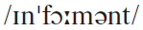
Words & Phrases
Words & Expressions
informant n. [C] (fml)
1. a person who furnishes linguistic or cultural information to a researcher 资料提供人（尤指为研究者提供语言、风俗资料的人）
e.g.
1. Could you be my language informant for Dutch?
你愿意作荷兰语的资料提供人吗?
2. They got the information from the literature resource and key informants.
他们从文献资料和一些主要的资料提供人处得到了这个信息。

Slide 39
Words & Phrases
Words & Expressions
2. sb. who secretly gives information about sb. to the police or sb. in authority 检举人；告密者
e.g.
1. The police chief says the informant is being kept in protective custody. He will be questioned by the FBI.
警官说该告密者已经保护性拘留，他将会受联邦调查局的审问。
2. Once the report is verified, the relevant supervision and administration department of food safety shall reward the informant.
举报经查证属实的，有关的食品安全监督管理部门应当对举报人给予奖励。
Word family: inform v. information n.

Slide 40
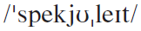
Words & Phrases
Words & Expressions
speculate vi.
1. (on/about) to consider or discuss why sth. has happened or what might happen 思索；猜测；推测
e.g.
1. We can only speculate about why he did it.
我们只能猜测他做这件事的理由。
2. We can only speculate on the reasons for his sudden resignation.
我们只能猜测他突然辞职的原因。

Slide 41
Words & Phrases
Words & Expressions
2. to take the risk of investing your money in a company in the hope that you can make a big profit later by selling the shares that you buy 投机，做投机买卖
e.g.
1. Ned had speculated in gold and lost heavily.
内德曾做过黄金投机买卖，损失惨重。
2. I was told her husband got much by speculating in shares / stocks.
我听说她丈夫靠股票的投机买卖赚了很多钱。
Word family:
speculation n. speculative a.

Slide 42
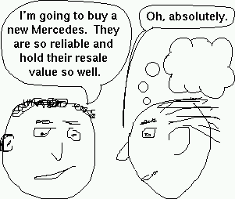
motive
Words & Expressions
n. the reason that you do something
Complete the sentences with suitable words.
The motive ________ the attack is not clear.
People thought he must have an ____________ motive for wanting to help.
When he visited her at home again, she started to ___________ his motive.
for
underlying
question

Slide 43
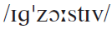
Words & Phrases
Words & Expressions
exhaustive a. thorough or complete; including every possible element 彻底的；完全的
e.g.
1. An exhaustive investigation of the facts proves the contrary.
彻底地调查事实后发现情况正好相反。
2. Although criminologists have conducted exhaustive research regarding the subject, little evidence exists to support the claim.
虽然刑事学家就这一课题做了详尽的研究，几乎没有证 据能支持这种说法。

Slide 44
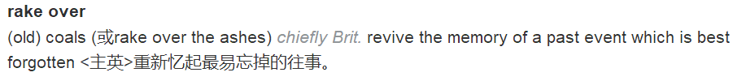
Words & Phrases
Words & Expressions
rake over
Why did you have to rake over his political past?
你为何非提他的政治历史不可？
In fact, although scholars still rake over the causes of the Depression, few think the 1929 crash contributed much.
事实上，尽管学者们仍会重提大萧条的直接原因，但很少有人认为1929年（的股市大崩盘）是最主要的导火索。

Slide 45
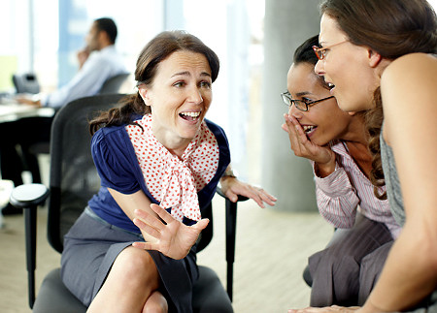
Words & Phrases
Words & Expressions
The feedback rule
animated
enthusiastic

Slide 46
■ appreciative
Words & Expressions
adj. showing that you are grateful or you enjoyed something
Complete the sentences with the words in the box.
appreciate appreciated
appreciation appreciative
Many of the junior staff feel that they are properly _____________.
I would ______________ it if you would just let me deal with it.
He was sincerely ________________ of their support.
The award is give in _______________ of her huge contribution to the film business.
appreciated
appreciate
appreciative
appreciation

Slide 47
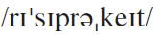
Words & Phrases
Words & Expressions
reciprocate v. (fml) to do or give sth., because sth. similar has been done or given to you
回报；回应
e.g.
Your visit gives me the chance to reciprocate some of the kindness and hospitality that was extended to me and my colleagues during our visit to Paris in March this year.
你们的来访使我有机会一尽地主之谊，答谢你们在我和我的同事今年三月访问巴黎期间的盛情款待。
Word family: reciprocation n.
reciprocal a.

Slide 48
Words & Phrases
Words & Expressions
Translate the following sentences into Chinese:
1. Although she did not reciprocate his feelings, she did not discourage him.
尽管她没有回应他的感情，她也没有使他丧失信心。
2. Some people who has been “given face” feels that he or she has received a favour. In turn, he or she has to reciprocate the favour so that the other party will not lose face.
在有些人看来，人家“给了面子”，自己便是得了人情， 因此必须投桃报李，以便使对方也不失面子。

Slide 49
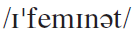
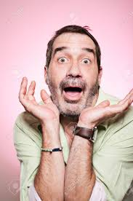
Words & Phrases
Words & Expressions
effeminate a. an effeminate man looks, behaves, or speaks like a woman （男子）女人气的
e.g.
1. He spoke in an effeminate voice.
他讲起话来一副娘娘腔。
2. There’s nothing effeminate about ballet
— you have to be incredibly fit to dance.
芭蕾并不女孩子气——你得要有十分健康
的体魄才能跳好。

Slide 50
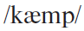
Words & Phrases
Words & Expressions
camp a. (of a man) behaving in a way that does not follow traditional ideas about male behaviour, especially in order to attract attention（尤指男子为引人注意而行为）忸怩作态的，稀奇古怪的；坎普
e.g.
While it’s not true that camp taste is homosexual taste, there is no doubt a peculiar affinity and overlap. (Susan Sontag)
尽管不能说坎普趣味就是同性恋趣味，但毫无疑问这两者之间存在着某种特别的契合和重叠之处。（苏珊·桑塔格）

Slide 51
etiquette
Words & Expressions
n. a set of rules for being correctly in social situations
Discuss the topic: Etiquette can vary widely between different cultures and nations.
In China, a person who takes the last item of food from a common plate or bowl without first offering it to others at the table may be seen as a glutton (贪吃鬼) and insulting the generosity of the host.
In America a guest is expected to eat all of the food given to them, as a compliment to the quality of the cooking.

Slide 52
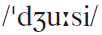
Words & Phrases
Words & Expressions
juicy a. (infml) juicy stories are slightly shocking but interesting or fun to listen to 生动有趣的，绘声绘色的
e.g.
1. He gets all the juicy jobs.
他把有趣的活儿都揽去了。
2. Many of us will no doubt still remember the juicy details on President Bill Clinton’s affair in the American media.
我们很多人无疑还记得比尔·克林顿总统的丑闻在美国媒体上详尽的报道。

Slide 53
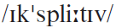
Words & Phrases
Words & Expressions
expletive n. [C] (fml) a rude word that you use when you are angry, annoyed, or upset that might offend some people 秽语；骂人的话
e.g.
1. The station bleeped out the expletives from the taped interview.
电台把采访录音中骂人的话抹掉了。
2. He uttered several vigorous expletives when he dropped the iron on his foot.
他的熨斗掉下砸在脚上，他骂了几句难听的脏话。

Slide 54
masculine
Words & Expressions
adj. with qualities thought to be typical of men
Translate the sentences.
She presented an intriguing combination of feminine looks with a masculine mind.
人们在她身上看到了女子的容貌、男子的志气。
她穿着那套衣服看上去有些男性化.
She looks rather masculine in that suit.
Discuss the topic: What are masculine physical attributes that females find as most attractive?
Broad chins and shoulders, high cheekbones, and large eyes

Slide 55
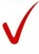
rake over
Words & Expressions
Answer the question about rake over.
If you rake over something, do you (a) want to forget it, or (b) keep talking about it?
Discuss the meaning of idioms.
There is no point in raking over the ashes now, you did what you thought was right at the time.
to think about or to talk about unpleasant events from the past
2. He daren’t be late for work again or the director will rake him over the coals.
to give someone a severe scolding
click
Usage notes: Ashes are what is left of something after it has been destroyed by fire.
click
Usage notes: The terms allude to the medieval torture of pulling a heretic over red-hot coals. (Early 1800s)

Slide 56
to the effect that
Words & Expressions
showing that you are giving a general idea of what someone said instead of their actual words
大意是；大致是
Translate the sentences.
1. He made a speech to the effect that we would all keep our jobs even if the factory were sold.
他做了一次讲话，大意是说即使工厂被转让出售，大家仍能保住工作。
2. 我说了几句话，大意是我们很想尽快见到玛丽。
I said a few words to the effect that we would all meet Mary soon enough.

Slide 57
Useful Expressions
1.导致···的差异
1. account for the difference
2.“高雅”话题
2. “highbrow” subjects
3.重要的差别
3. significant difference
4.在内容上
4. in terms of content
5.···的神话仍然大行其道
5. the myth is still widely believed that
6.差别只在于···而非
6. the difference turns out to be
more …than …
7.不成文的规则
7. unwritten rule
8.主要因素
8. principal factors
9.语调活灵活现
9. highly animated tone
10.调门高
10. high-pitched tone

Slide 58
Useful Expressions
11.平缓、冷静的语调
11. in a flat, unemotional manner
12.引述别人的话
12. do the he-said-she-said thing
13.详细推测
13. detailed speculation about
14.关键因素
14. crucial element
15.语调生动
15. lively tone
16.好的听众
16. appreciative listeners
17.听起来像小女孩
17. sound girly
18.听起来女里女气
18. sound effeminate
19.特别有趣的闲话
19. a particularly juicy bit of gossip
20.表达诧异
20. convey one’s surprise

Slide 59
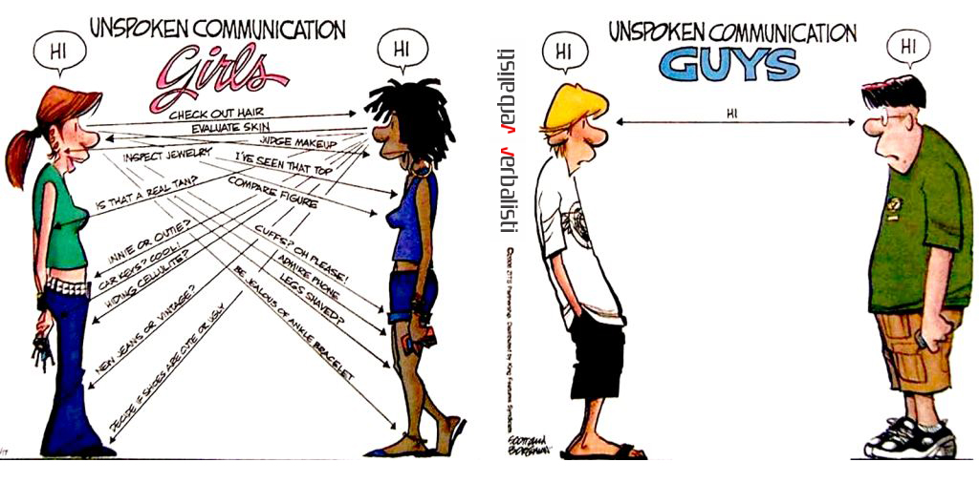
Discussion

Slide 60
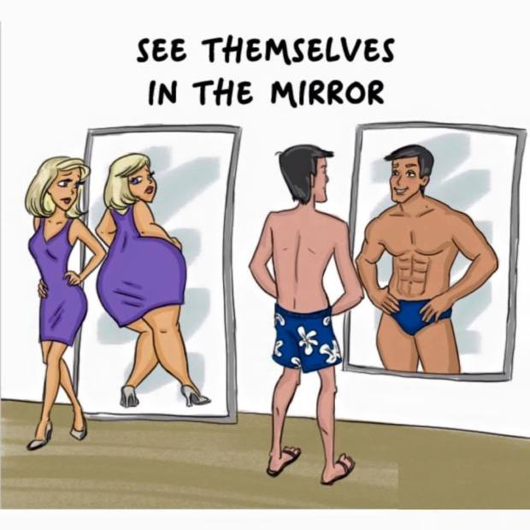
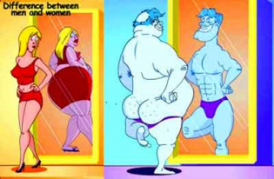
Discussion

Slide 61
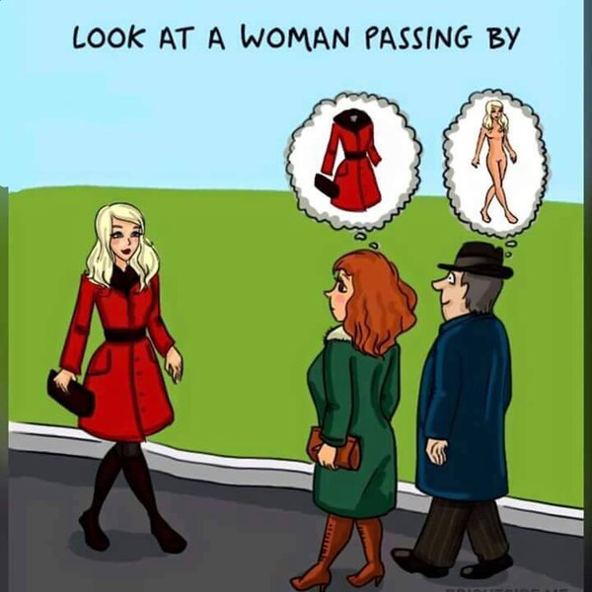
Discussion

Slide 62
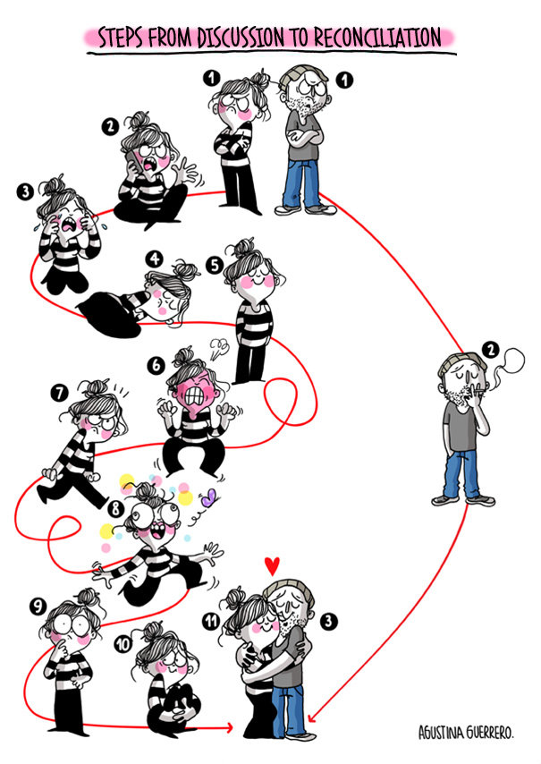
Discussion

Slide 63
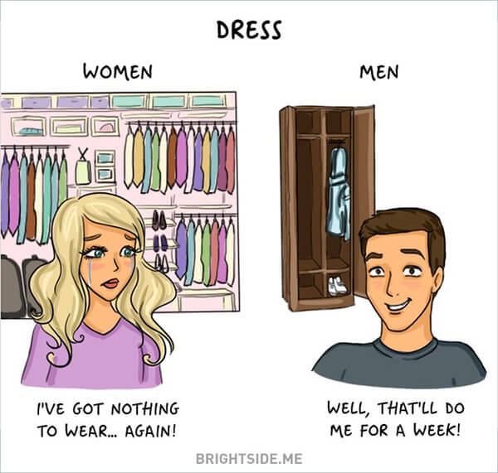
Discussion

Slide 64
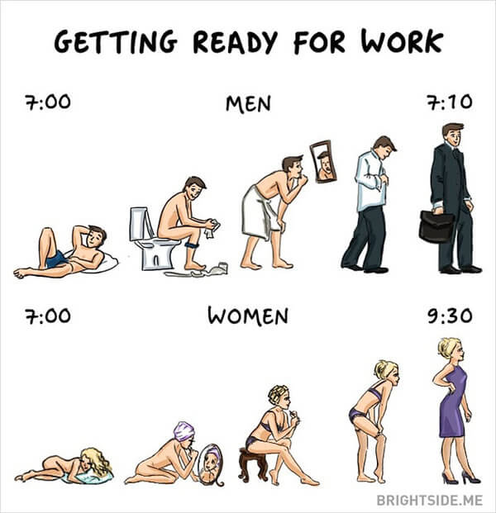
Discussion

Slide 65
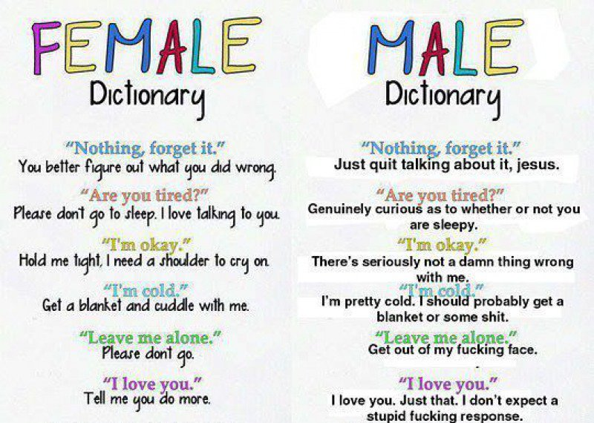
Discussion

Slide 66
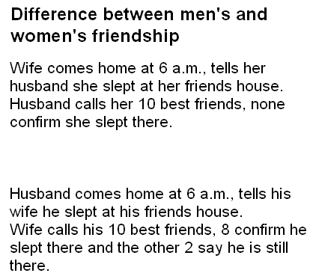
Discussion

Slide 67

Psychological distinctions
Listening
Listen to a recording about psychological distinctions between men and women and complete the table.

Slide 68
Psychological distinctions
Listening
 | Men | Women
1. Way of thinking | think globally
2. Creating |  | prefer to pass on knowledge
3. Thoughts and actions
4. Self-appraisal | higher
5. Sources of satisfaction
6. Strongest need |  | relationships
7. Attitude to pain and boring work | poor endurance
attention to details & nuances
prefer to take risks & experiment
more independent
more willing to follow other’s advices
lower
career & prosperity
family and kids
fulfill their goals
better endurance

Slide 69
Psychological distinctions
Listening

Slide 70

Origin of gossip
Cultural Notes
The word is from Old English godsibb, from god and sibb, the term for godparents, i.e. a child’s godfather or godmother. In the 16th century, the word assumed the meaning of a person, mostly a woman, one who delights in idle talk, a newsmonger (爱传播新闻的人), a tattler (说闲话的人). In the early 19th century, the term was extended from the talker to the conversation of such persons. The verb to gossip, meaning “to be a gossip”, first appears in Shakespeare.

Slide 71


